Slide 1
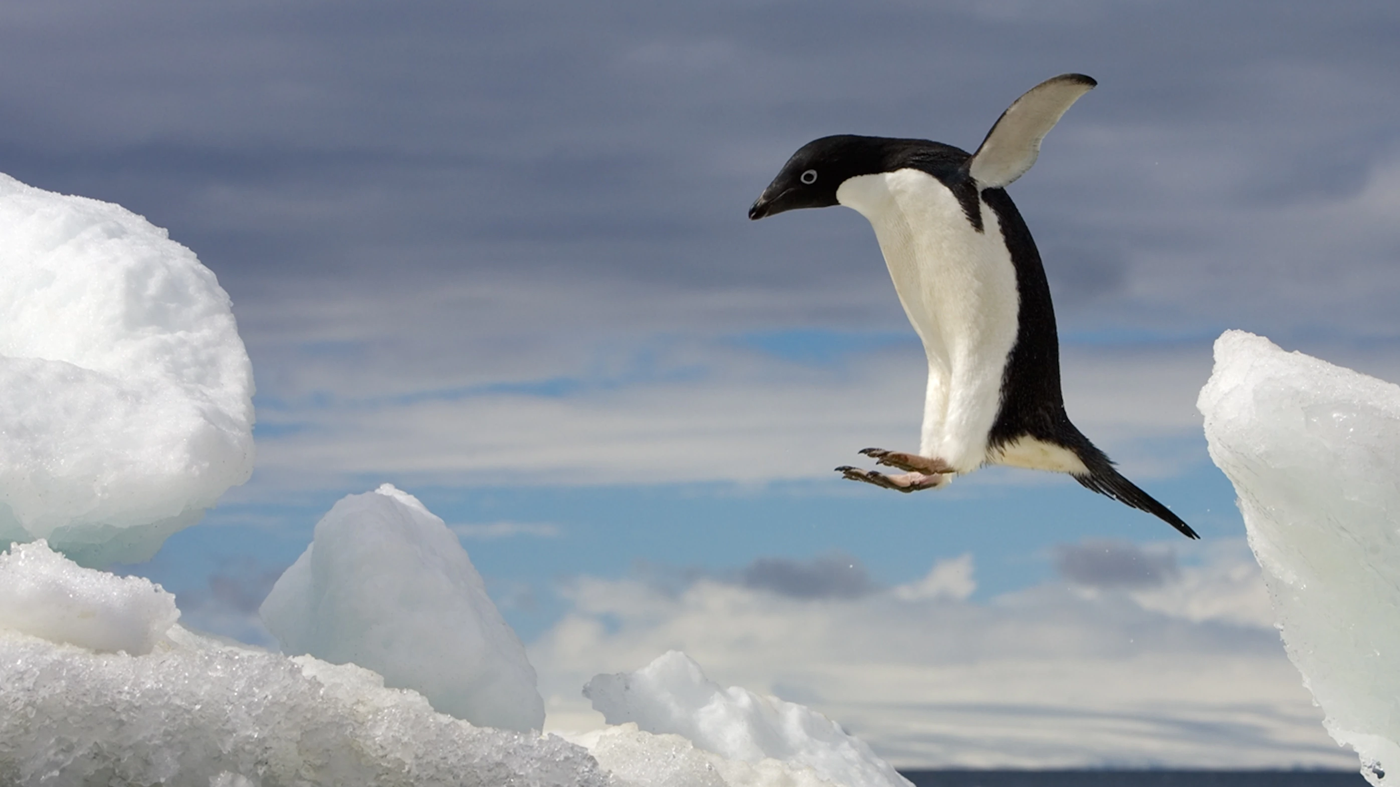
Penguins and Data Analysis
Benjamin Ford
Braxton Walk

Slide 2
Why Penguins?
To help penguin researchers
(Penguinologist)
Monitor Populations
Distribution of Species
Distinguishing Features for Each Species
And
For Survival Chances

Slide 3
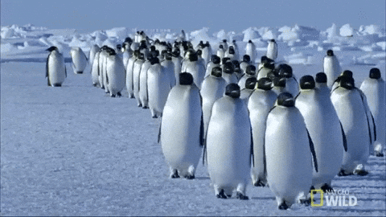

Slide 4
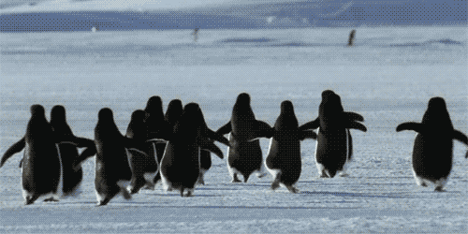

Slide 5
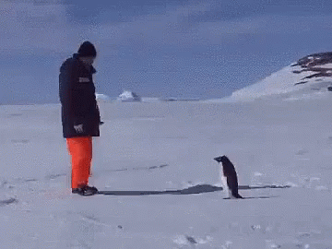
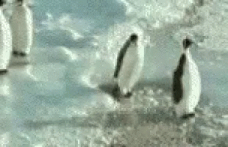

Slide 6
Because Penguins are Awesome!
Giant penguins once roamed the Earth
A group of penguins in the water is called a ‘raft’.
A group of penguins on land is called a ‘waddle’.
The tiniest penguin is approximately 10 inches tall.
During courtship, a male penguin will find the smoothest pebble to give to a female as a gift

Slide 7
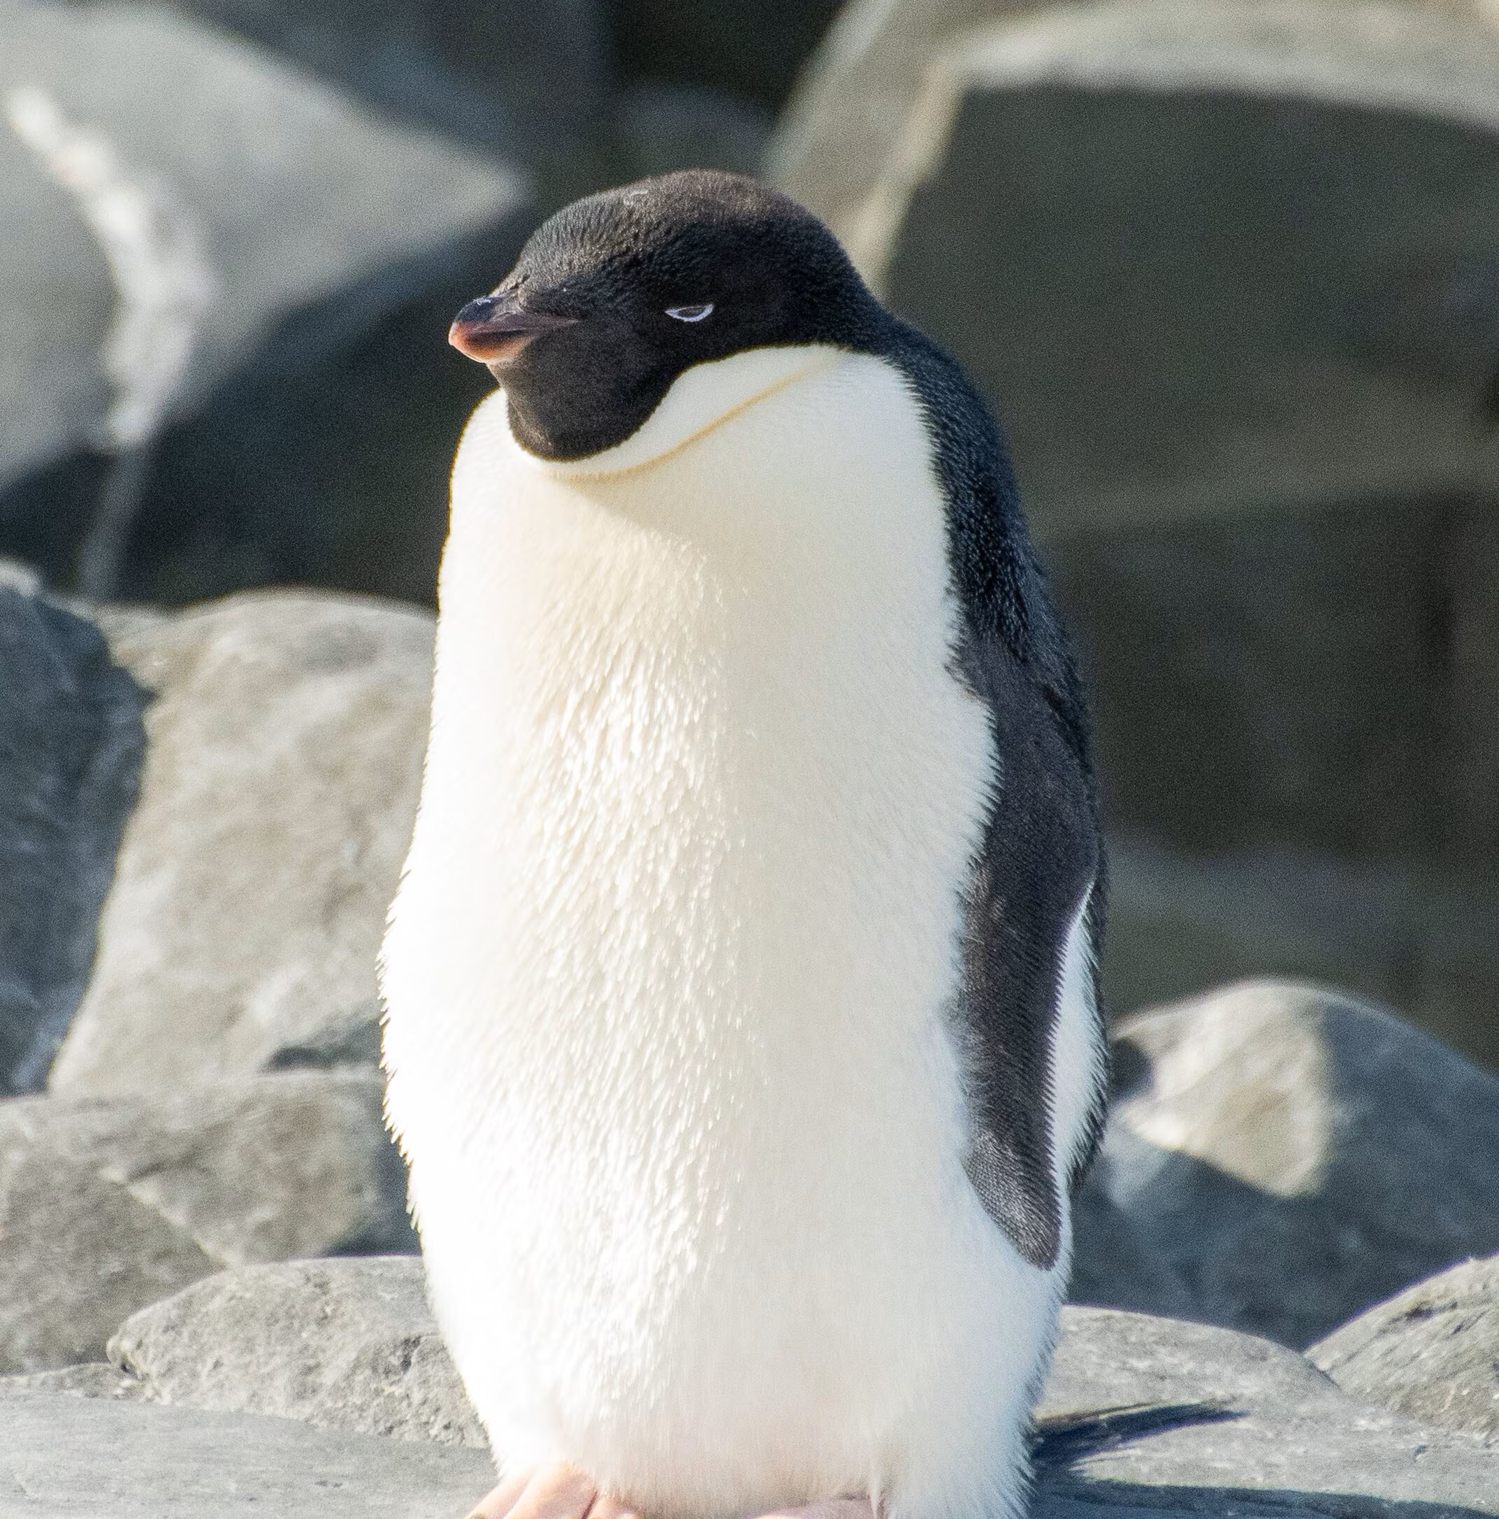
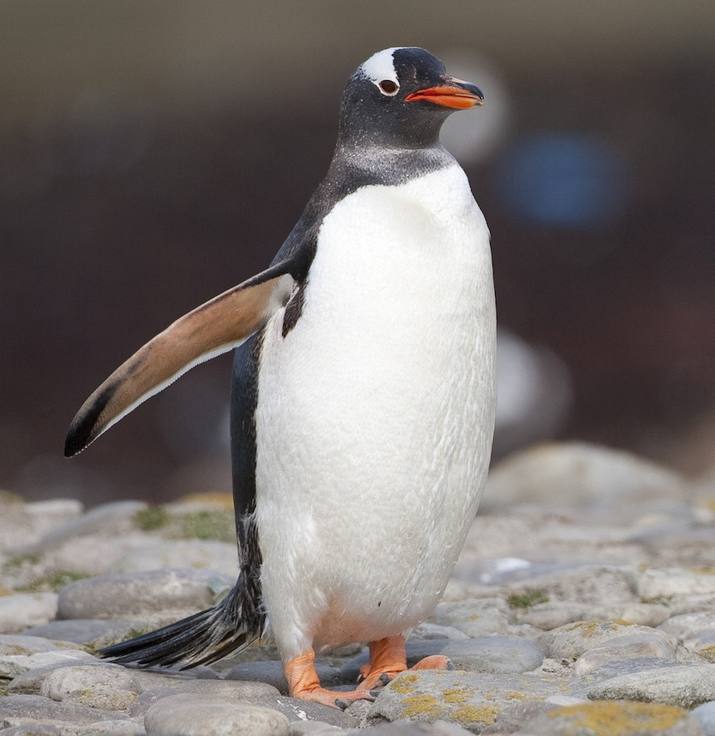
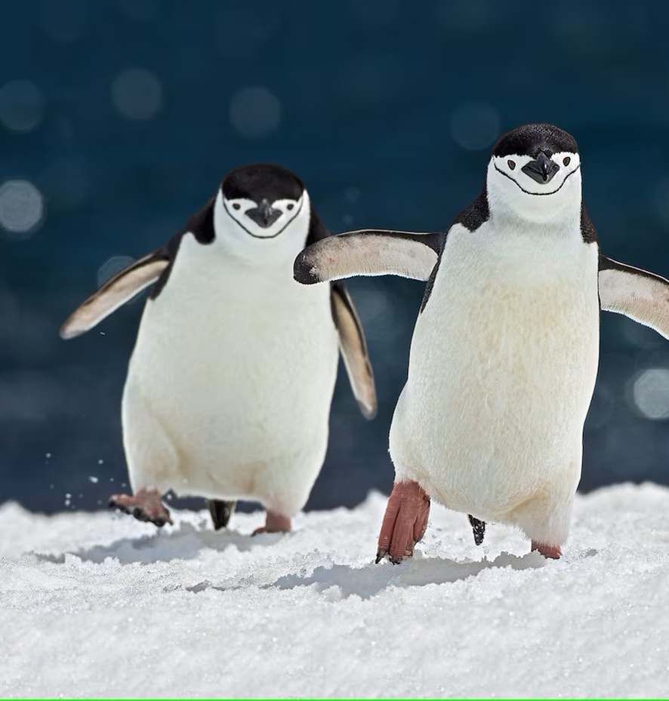
Species
Adelie Penguin
Gentoo Penguin
Chinstrap Penguin

Slide 8
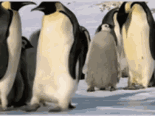
Problems With Our Data

Slide 9
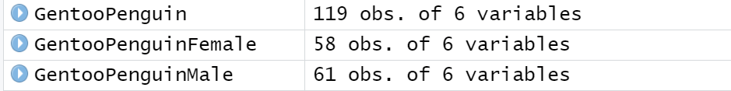
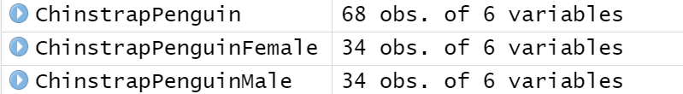
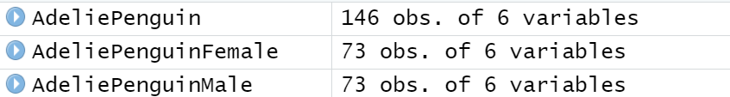
Data Break Down
35.7%
20.1%
43.8%

Slide 10
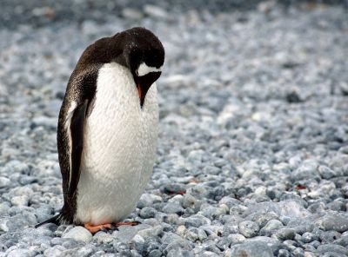
Not enough data!
Only have data for 344 penguins
We need more penguins!
What did we do?

Slide 11
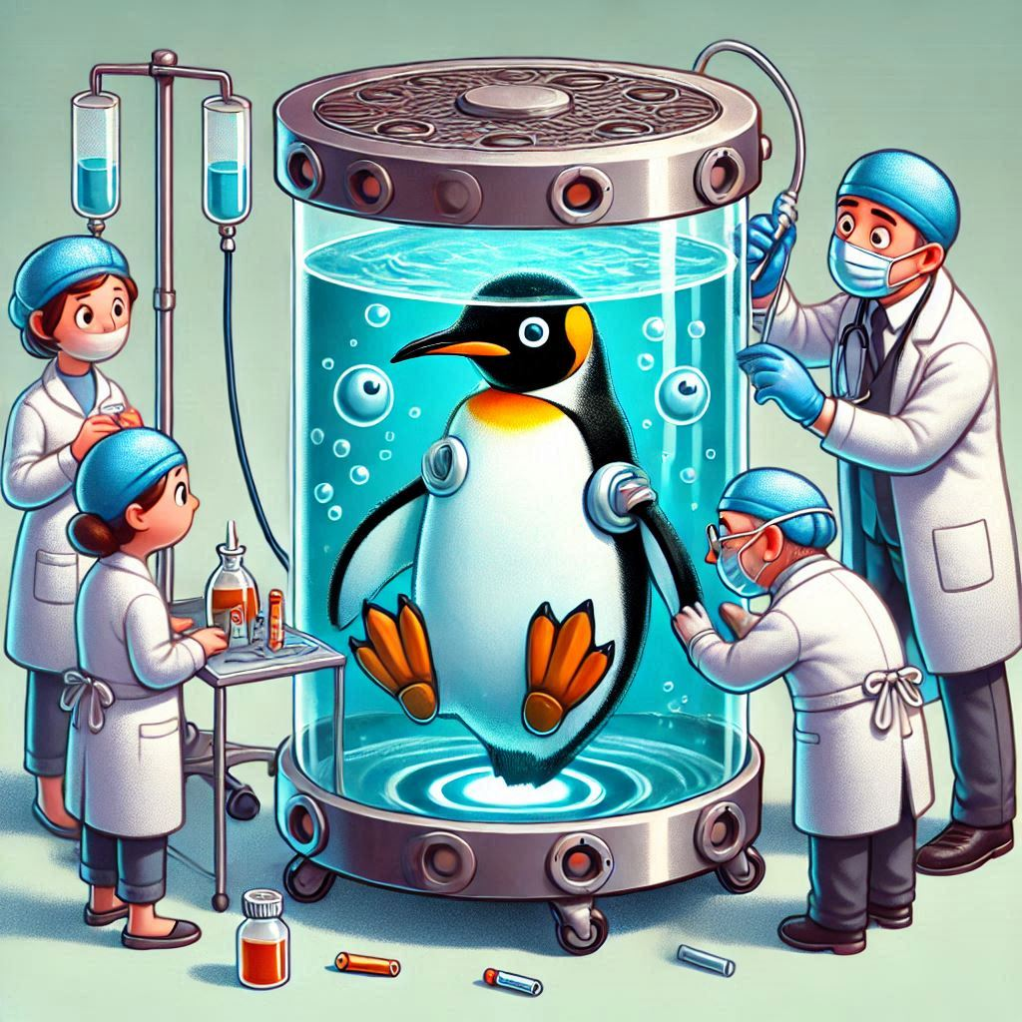
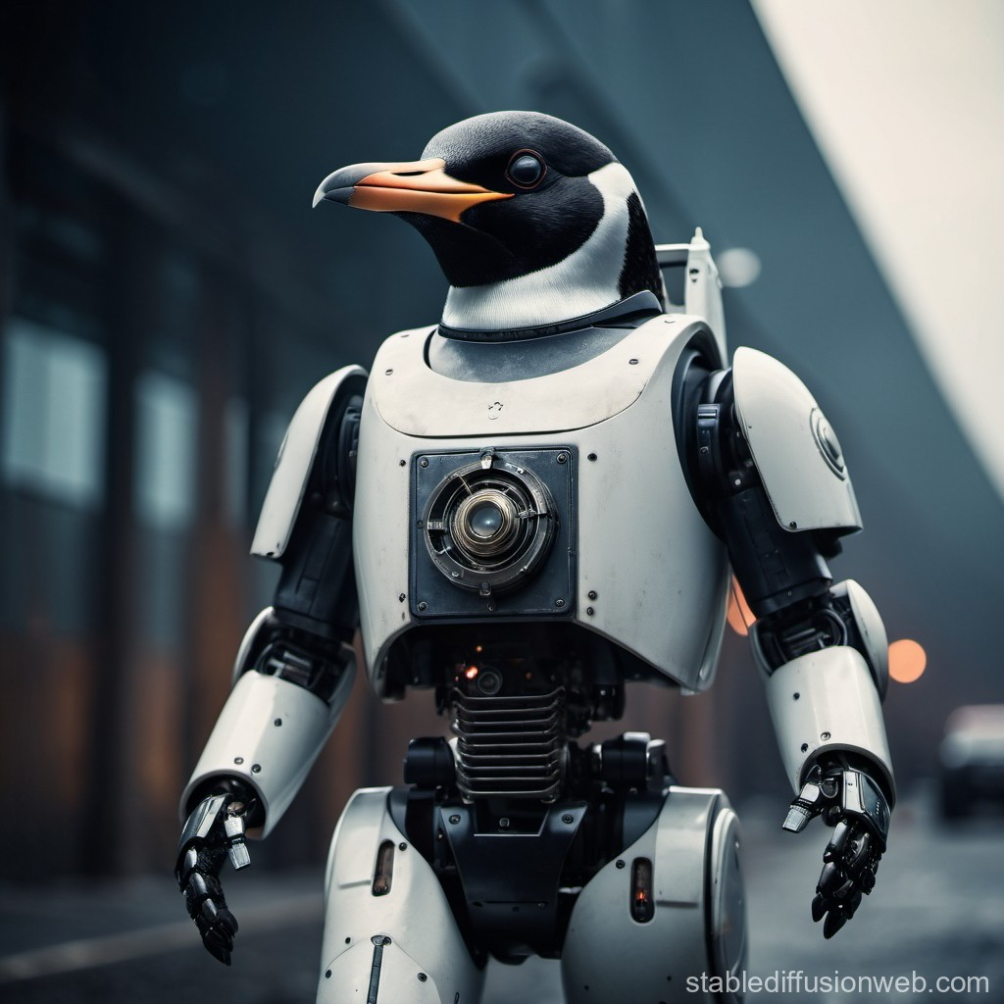
Artificial Penguins

Slide 12
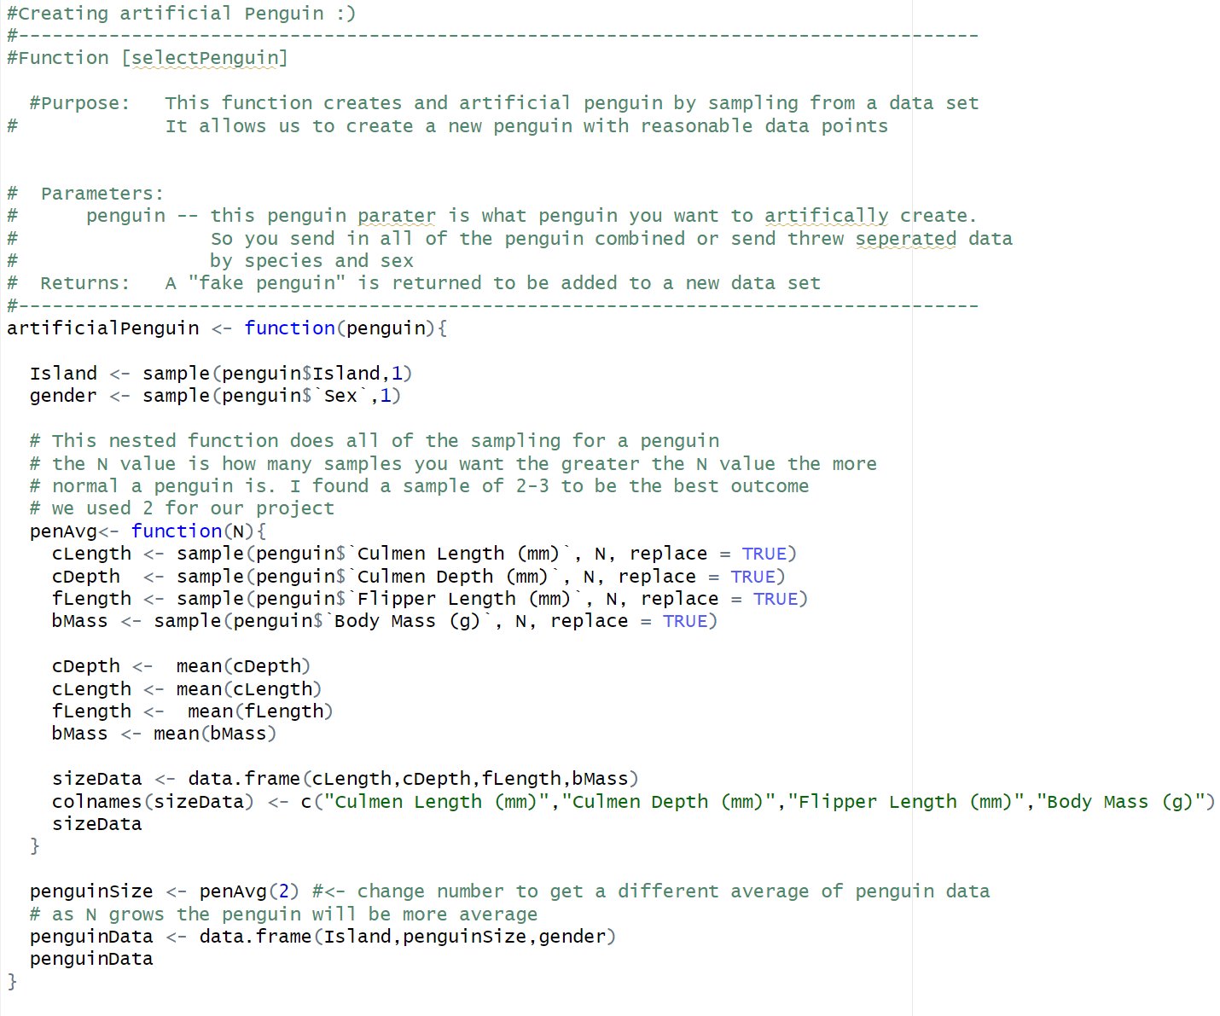
Sampling From Real Data
Our data was normally distributed
Enough data to create “fake penguins”
How did we make the penguins

Slide 13
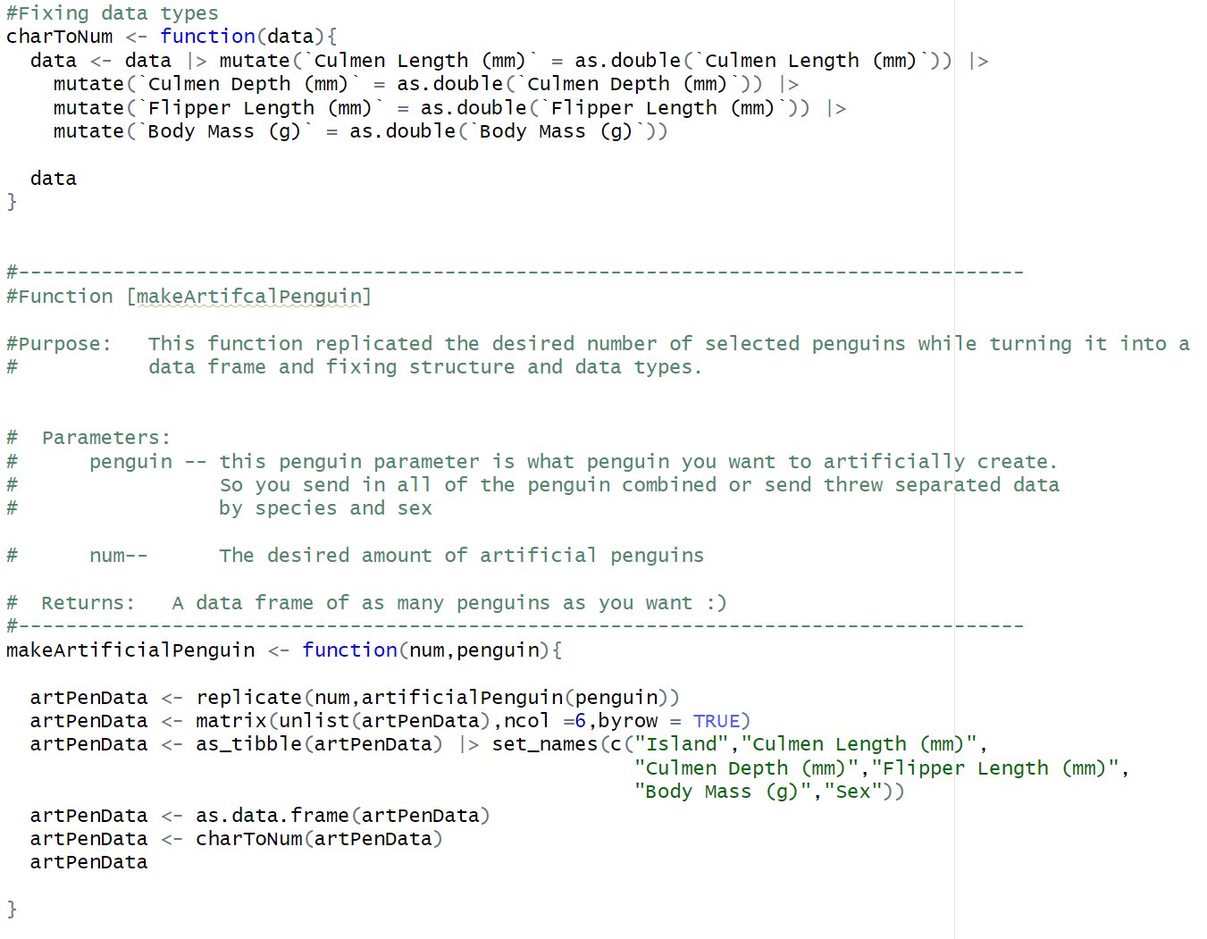
Replicating and Cleaning

Slide 14
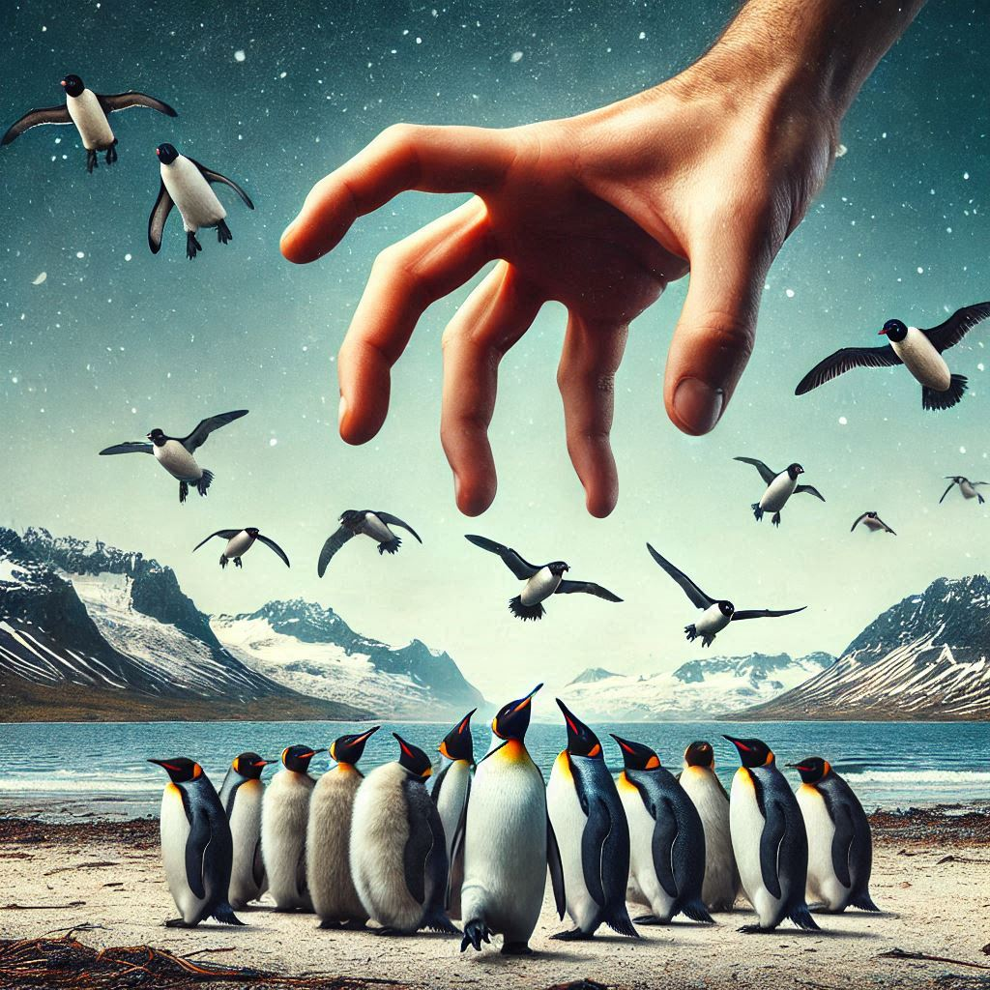
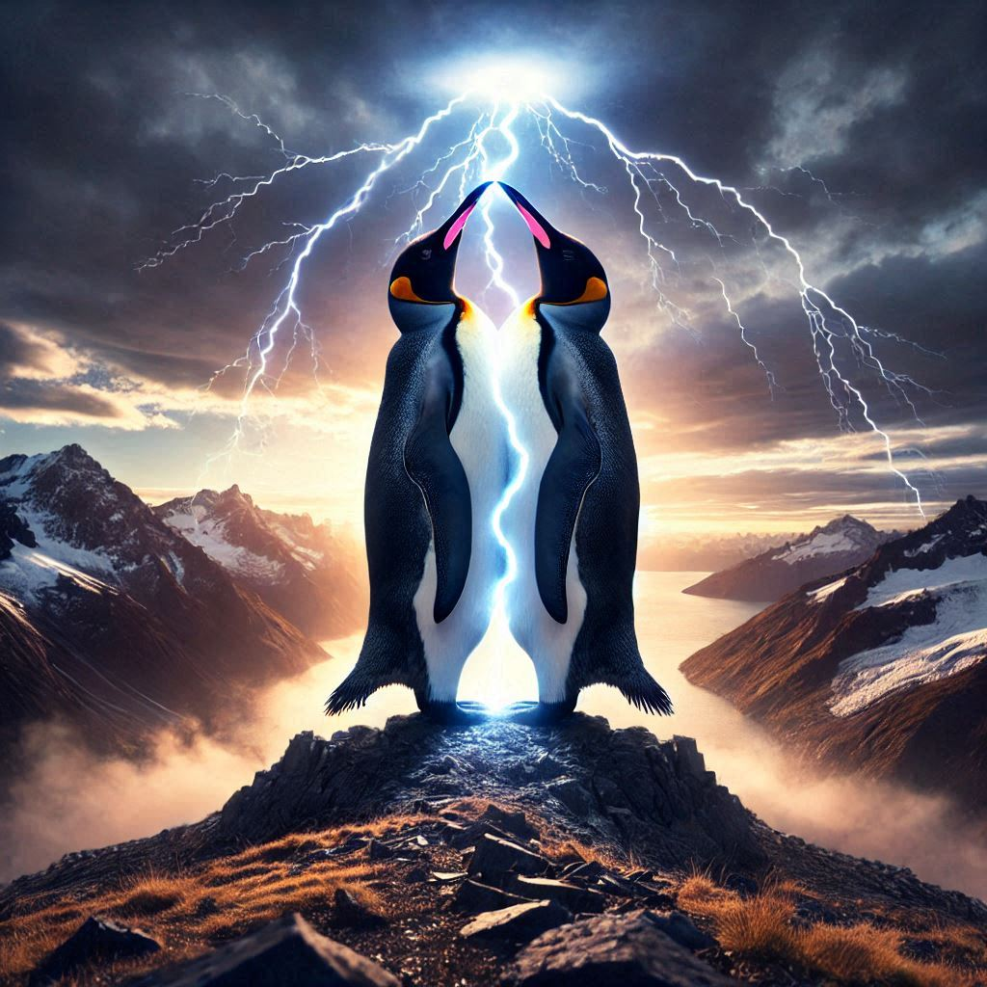

Slide 15
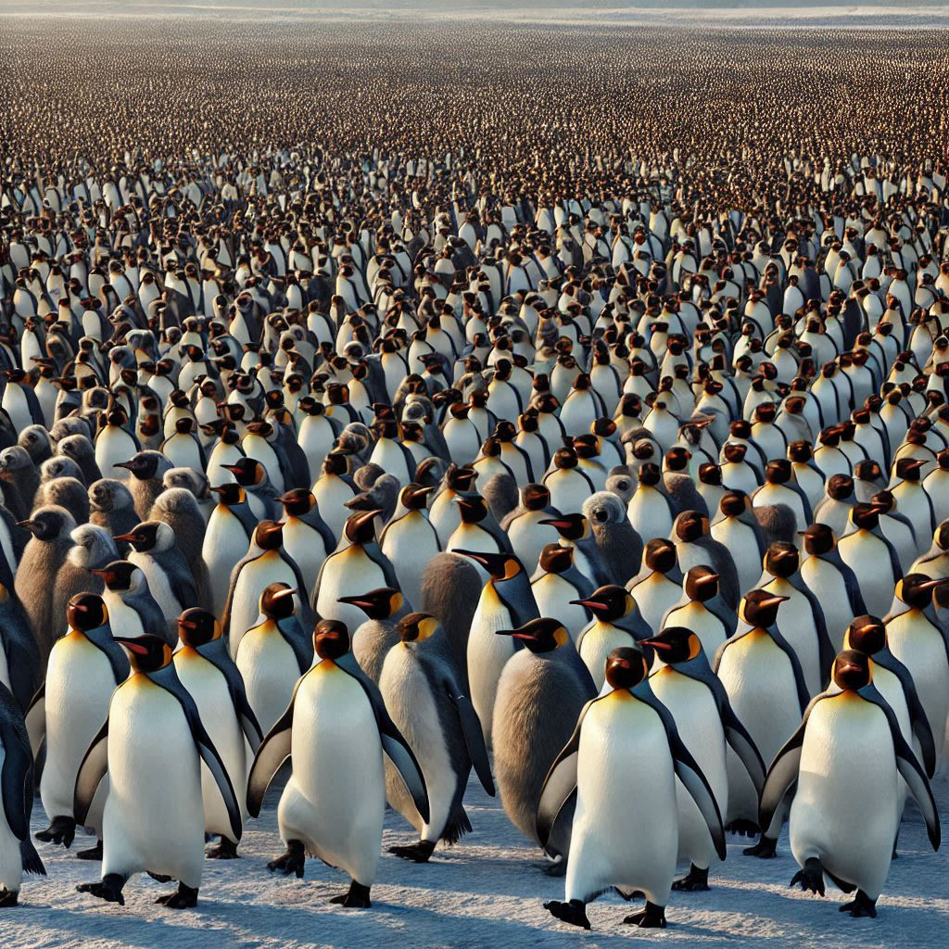
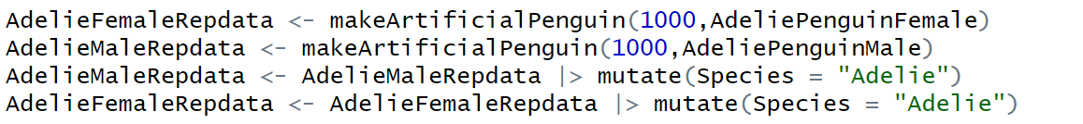
Penguin Army!

Slide 16
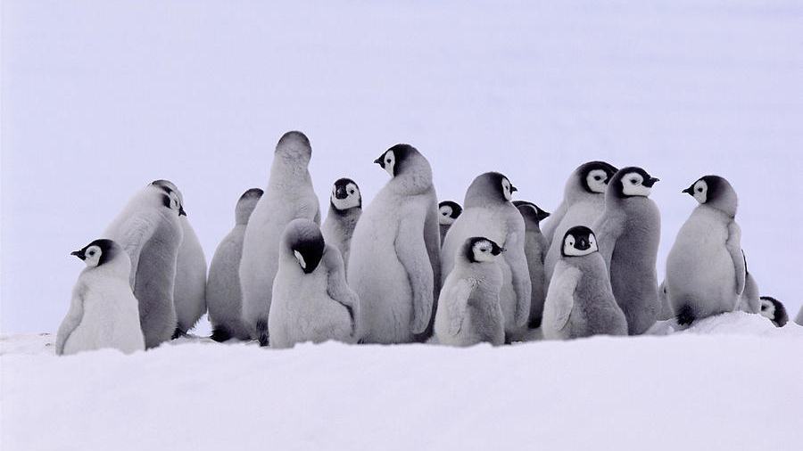
Distributions

Slide 17
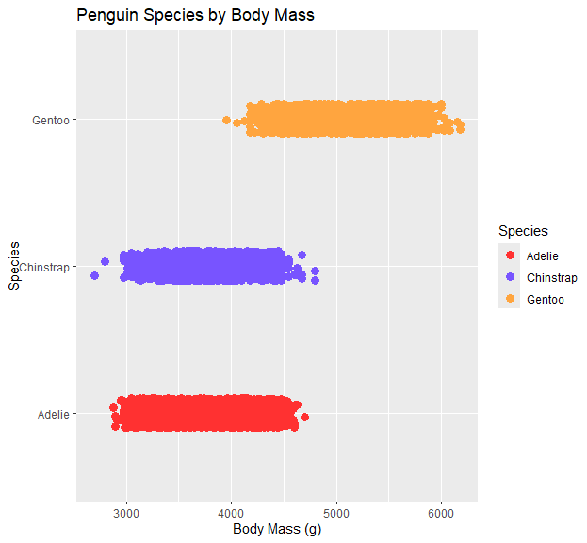
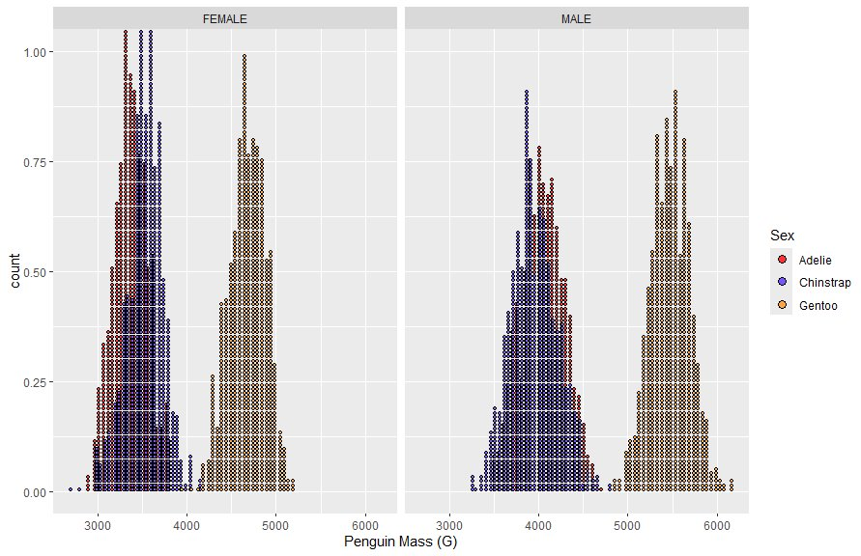
Body Mass for Species

Slide 18
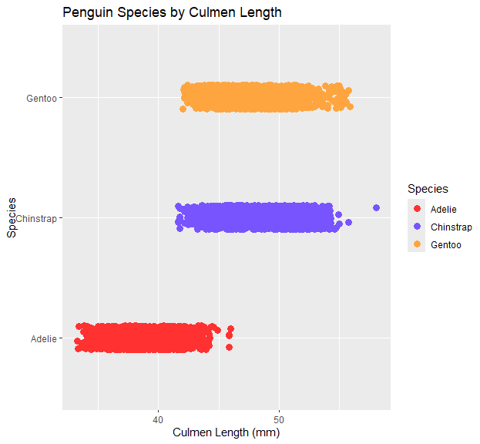
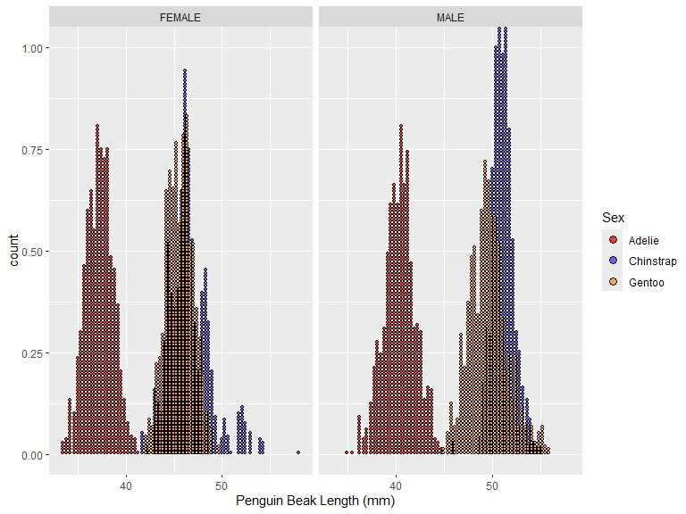
Beak Length for Species

Slide 19
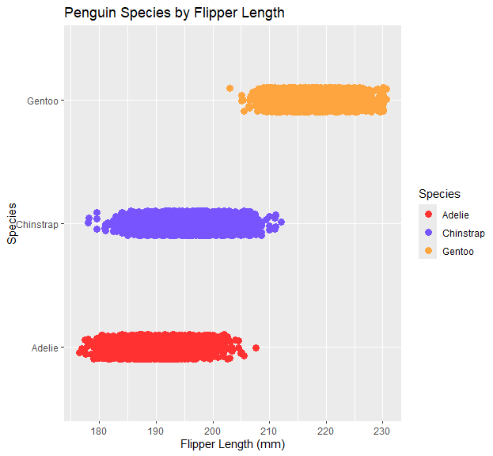
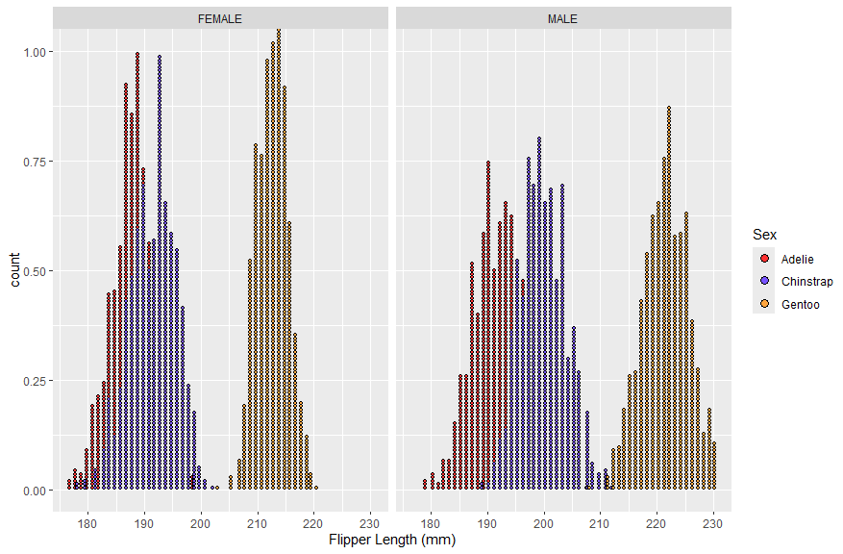
Flipper Length for Species

Slide 20
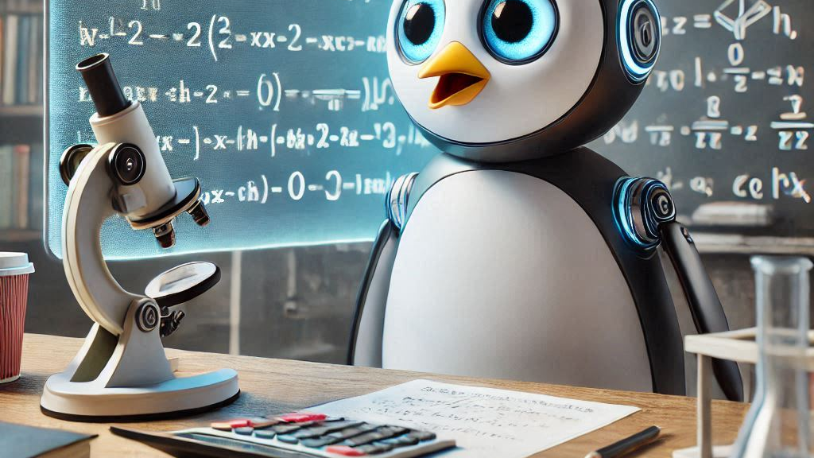
Machine Learning with Penguins

Slide 21
Multinomial Logistic Regression
"Predicts the probability of a categorical dependent variable with more than two possible outcomes (nominal data), based on one or more independent variables"
Dependent Variable – Species (Adelie, Gentoo, Chinstrap)
Independent Variables – Body Mass, Culmen Length, Culmen Depth, Flipper Length

Slide 22
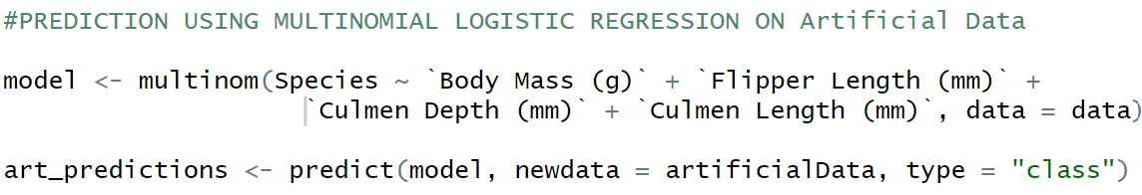
Multinomial Regression using nnet Library Artificial Data
Trained on original data points, predictions done on artificial data

Slide 23
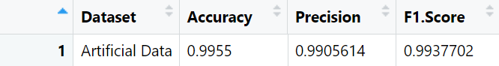
Predictions Based on Artificial Data

Slide 24
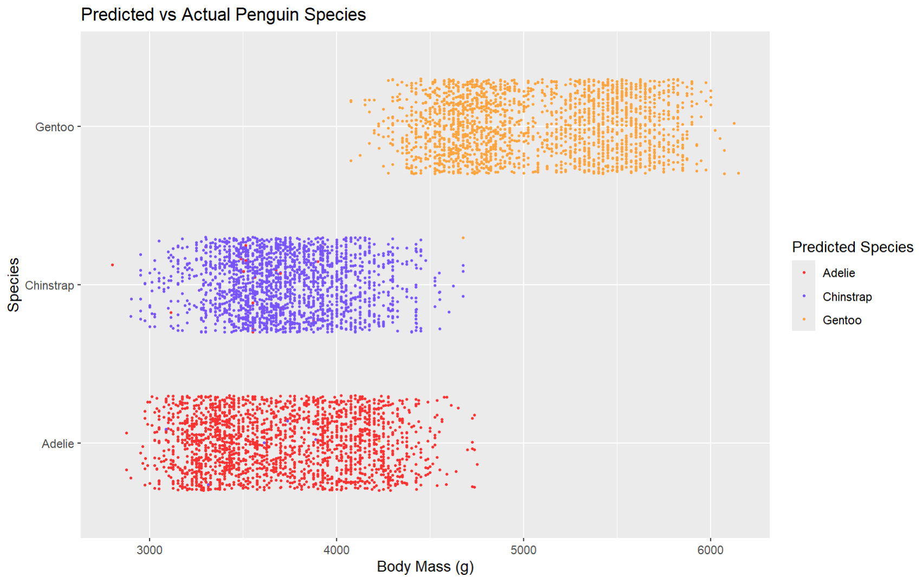
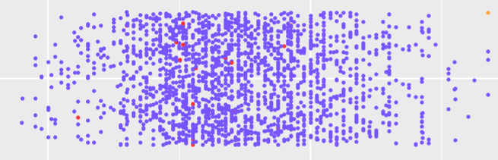
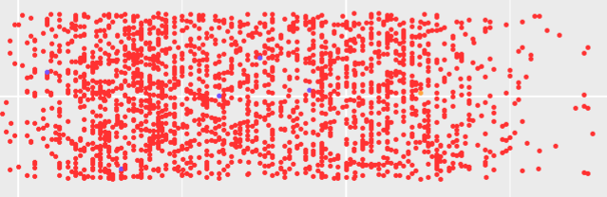

Slide 25
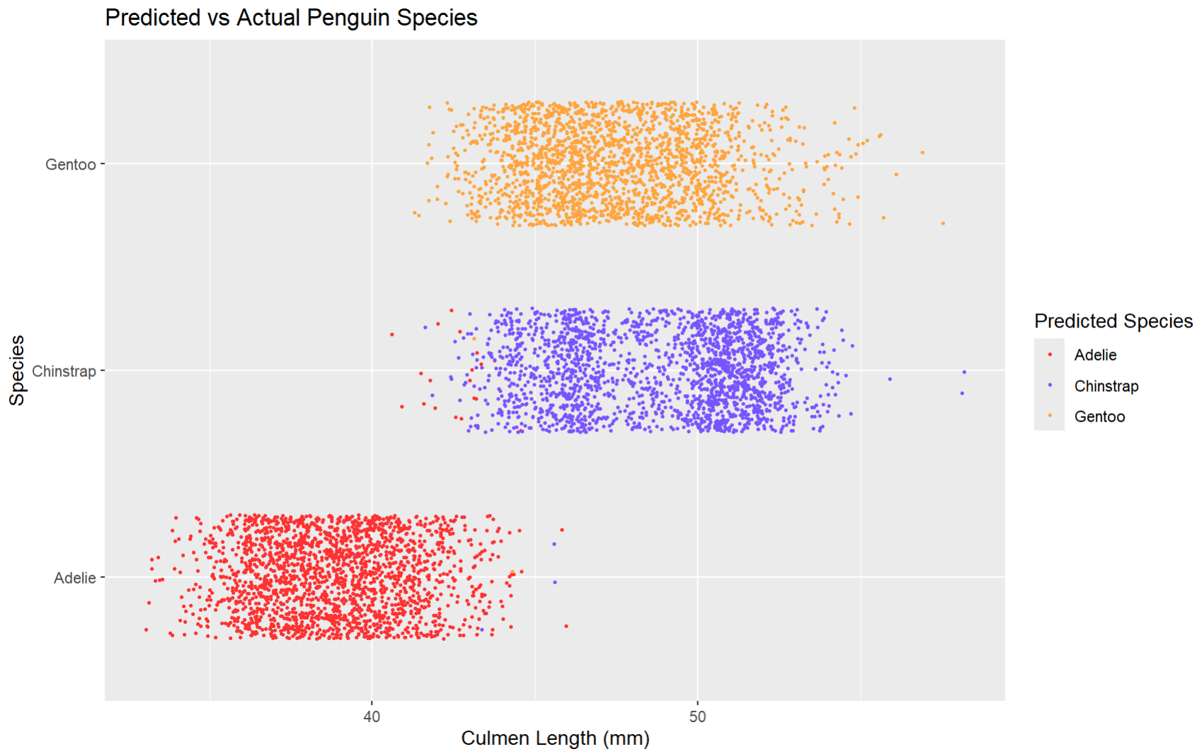
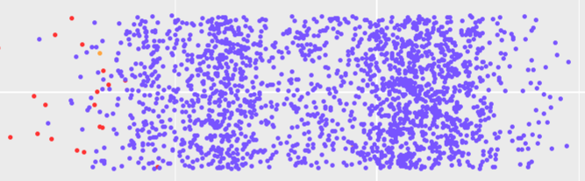
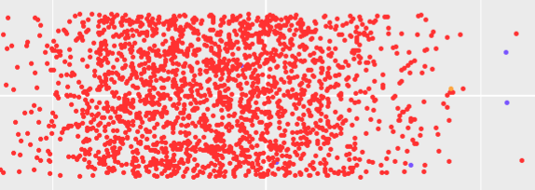

Slide 26
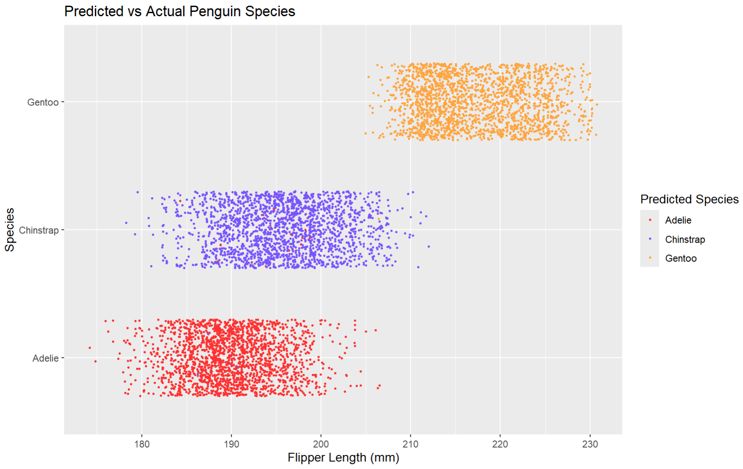
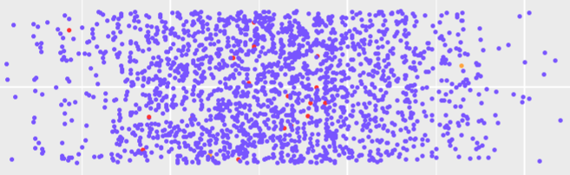
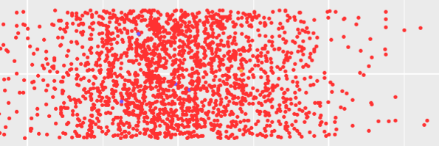

Slide 27
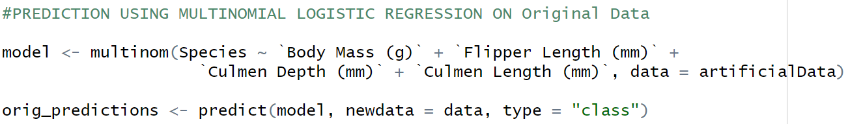
Multinomial Regression using nnet Library Original Data
Trained on artificial data points, predictions done on original data

Slide 28
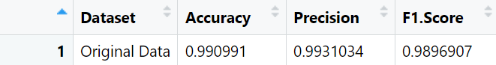
Predictions Based on Original Data

Slide 29
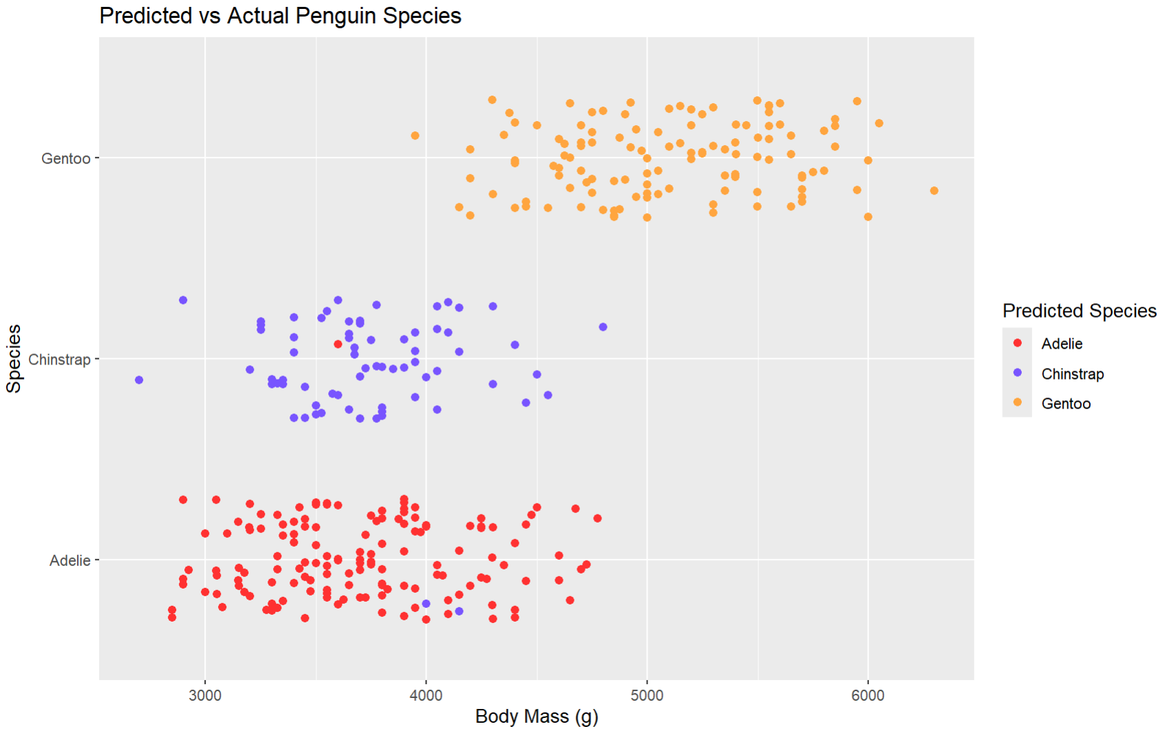
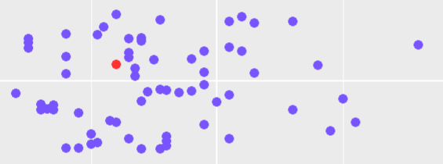
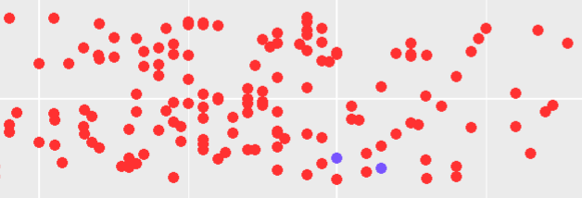

Slide 30
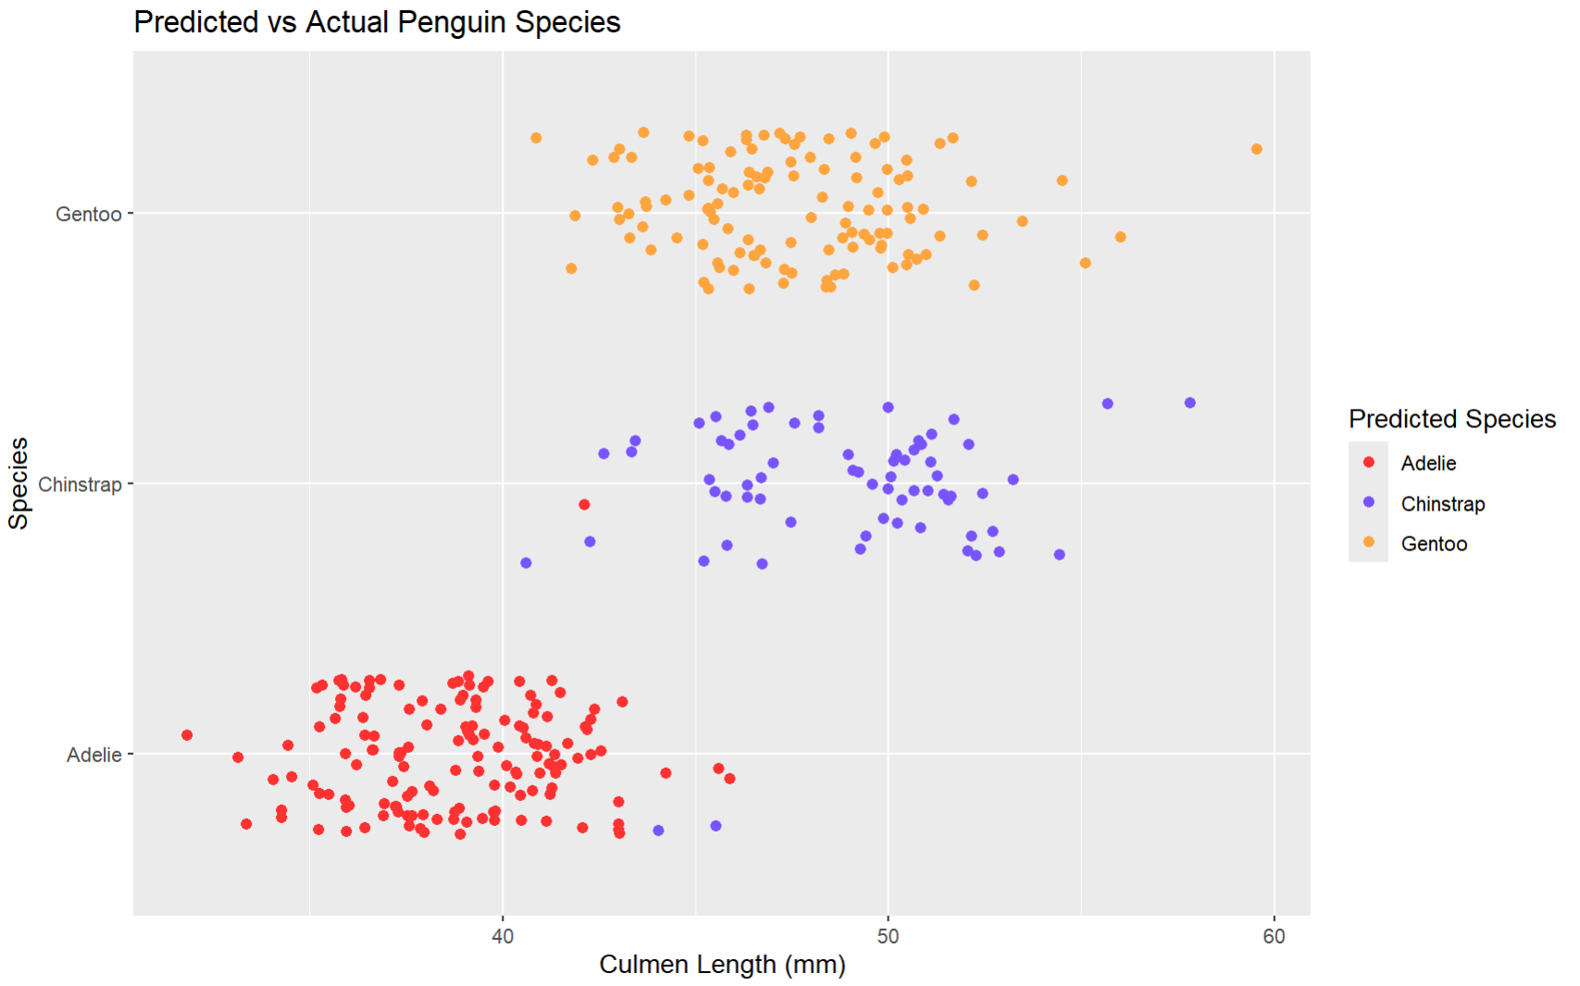
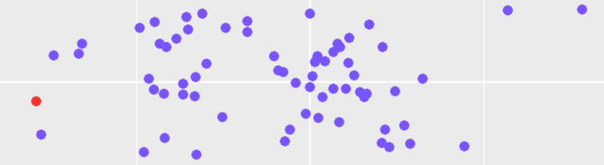
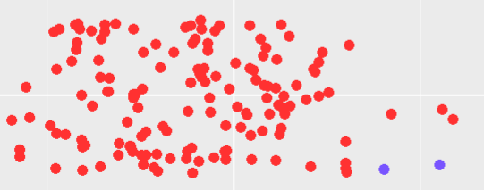

Slide 31
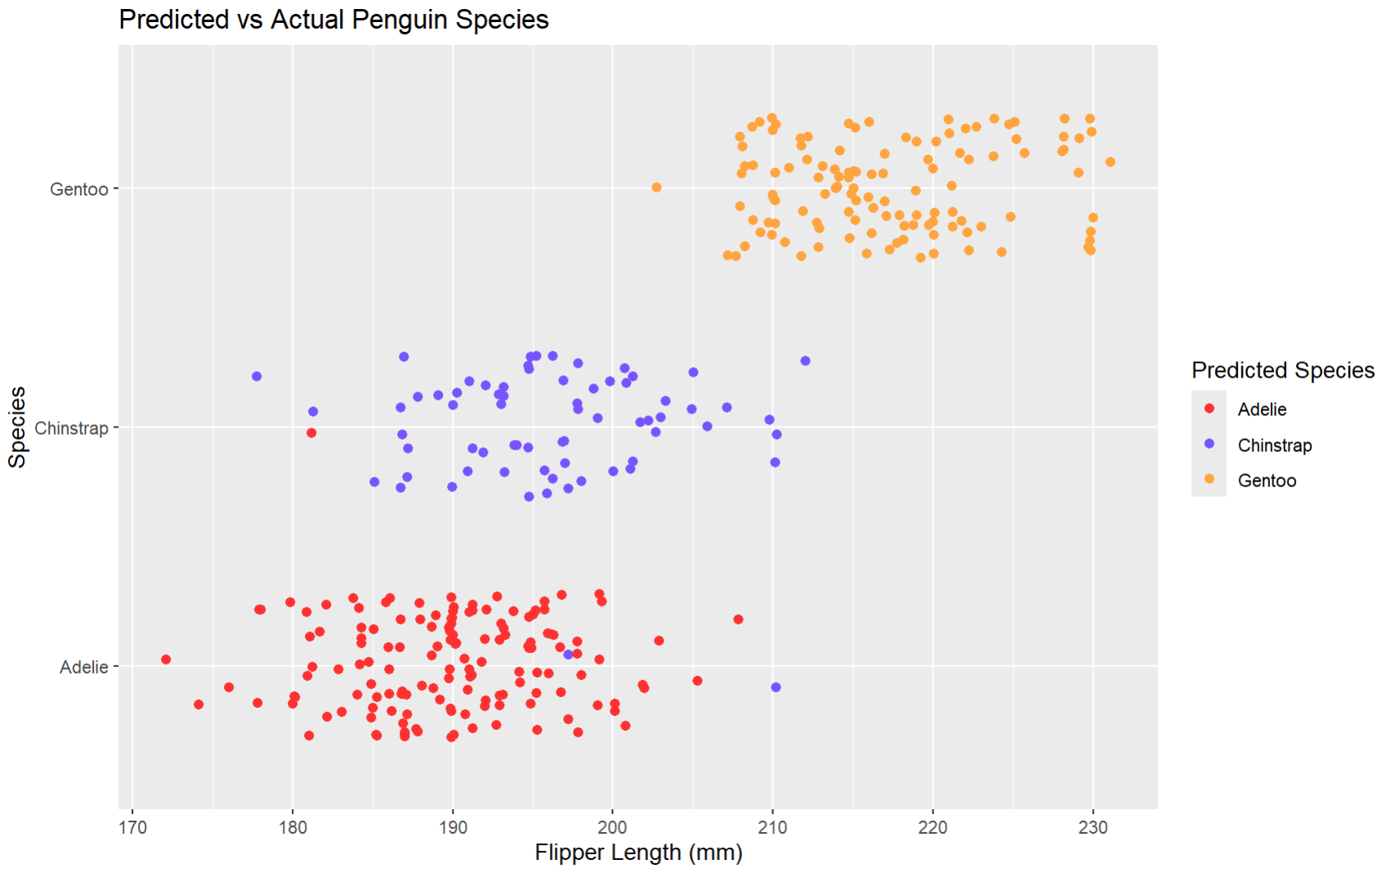
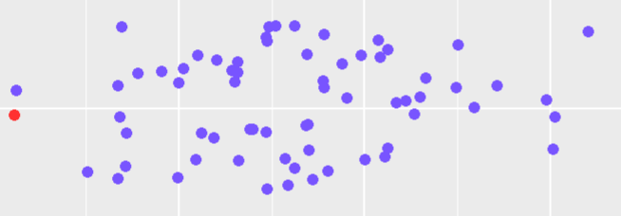


Slide 32

Predictions For Both Data Sets

Slide 33
WHY is our Original Data doing such a good job predicting?

Slide 34
Each variable has one species that is significantly different than the others.
This makes it easy to determine the correct species
Let's go back a few slides to see this...

Slide 35
Usage of Our Analysis
This model and data is important for penguin researches.
A researcher may forget to track certain features
Corrupted data can be filled with data that is reasonable so that efforts weren’t lost.
Allowed us to fill in the blanks with reasonable data
- Monitor Populations
- Health
- Survival Chance

Slide 36


THANKS FOR LISTENING!

